Slide 1
Friday, December 16, 2016
Write In Your Agenda:
Write In Your Monitoring Log:
CW:
Finish yesterday’s notes.
My Moon Measurements sheet.
HW:
Looking for donations of Oreo cookies for moon phases activity.
Response to Warm-Up:
What three phenomena does the moon affect on the Earth?
You will need:
Pencil
Yesterday’s note sheets

Slide 2
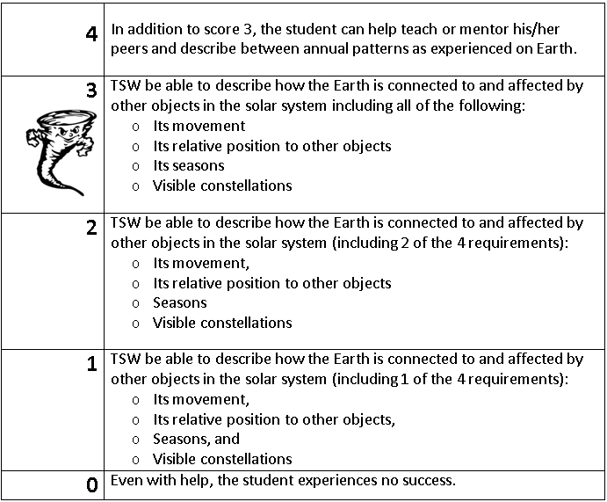
Learning Goal and Scale
TSW be able to describe how the Earth is connected to and affected by other objects in the solar system (including its movement, its relative position to other objects, its seasons, and visible constellations).

